Slide 1
Latent Dirichlet Allocation(LDA) and Non Negative Matrix Factorization (NMF) for Topic Modeling
Presented By:
Teresa Chu (B00690148)
Trupti Bhagoorkar (B00820305)
Joseph E Rivas (B00358083)

Slide 2
Introduction
Motivation
Topic Modeling :
Statistical Model
Use case
Latent Dirichlet Allocation (LDA)
Unsupervised Learning Approach
Use case

Slide 3
Required Packages
Python 3 - Pandas, Numpy
NLTK and spacy
Regular expression (re)
Gensim Package
Matplotlib
PyLDAvis
Sklearn

Slide 4
Dataset
Consumer Reviews on Amazon Products
Link: https://www.kaggle.com/datafiniti/consumer-reviews-of-amazon-products
Size of dataset
Features: Date, Product Name, Ratings, Reviews
Food Reviews
Link: https://www.kaggle.com/snap/amazon-fine-food-reviews
Size of dataset
Features: Product Name, Score, Summary ( Reviews)

Slide 5
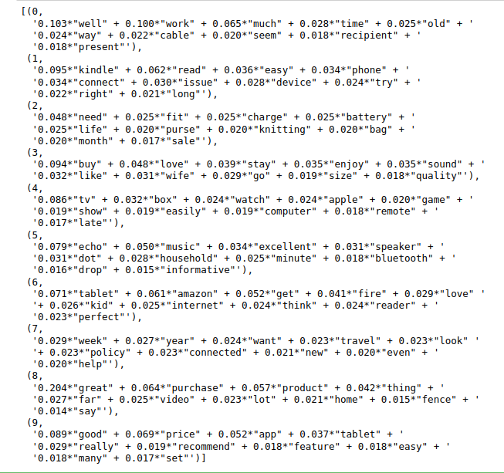
Results for LDA model on Amazon Dataset
Number of Topics : 10
Number of words: 10
Weights (values)
Discovered Topics:
Topic 1: Kindle Application: read, connect, device
Topic 4: Technological products: tv, watch, apple
Topic 5: Alexa : echo, music, dot

Slide 6
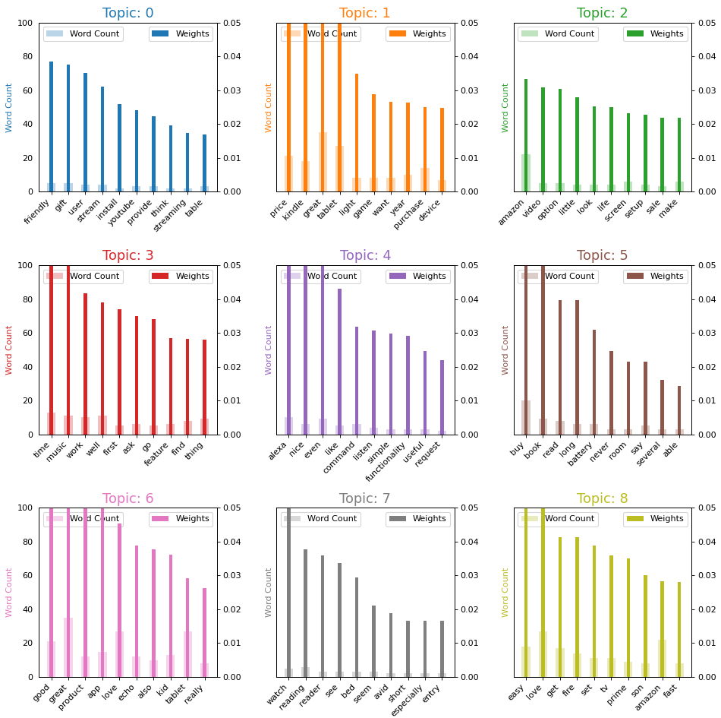
Results (Graphical Representation of LDA Results)

Slide 7
Preprocessing Data for Food Dataset
Changed all reviews to lowercase letters
Removed non alphanumerics such as . ! , - ...etc
Removed reviews less than 60 words to avoid short reviews without any context that would have not contributed much to the LDA model
Removed stopwords from a stopword text file which contained common English stopwords
Common stopwords became a relevant keyword in the topic despite not having much significance

Slide 8
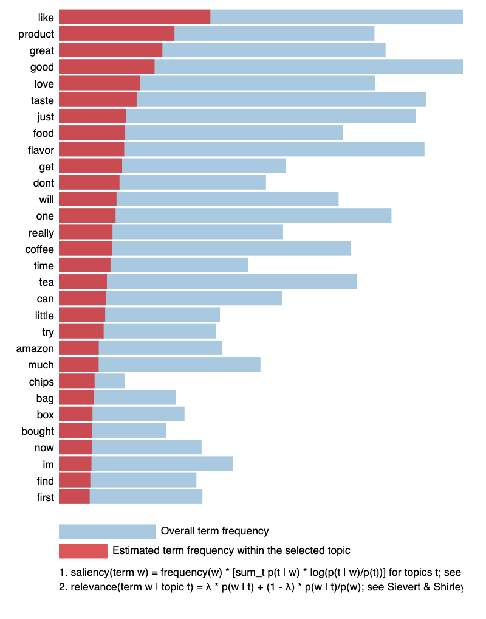

Slide 9
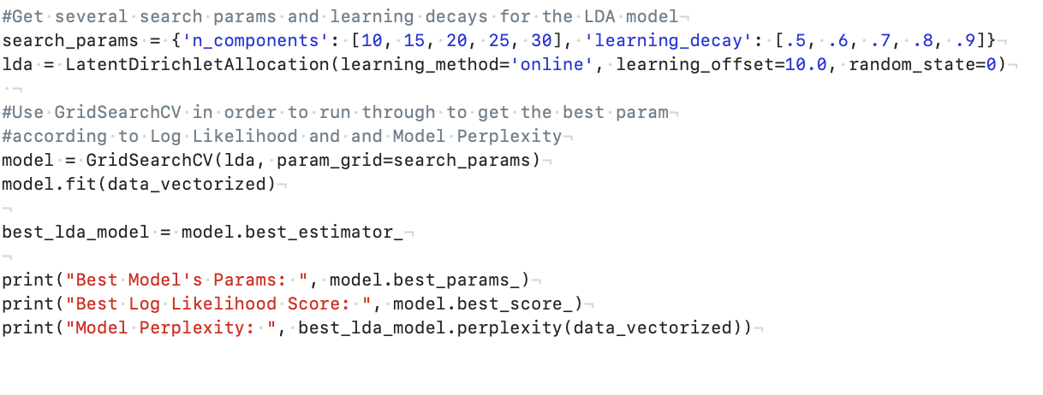
Log and Perplexity Score using sklearn module

Slide 10
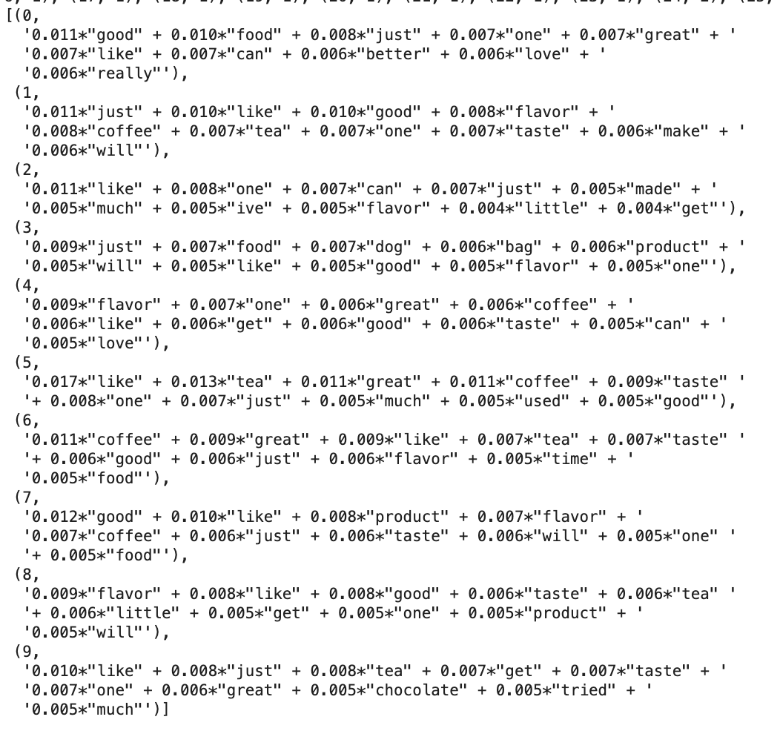
LDA model using gensim module
Notable keywords:
Good, like, great
Taste, flavor
Coffee and tea
Dog, cat, kids

Slide 11
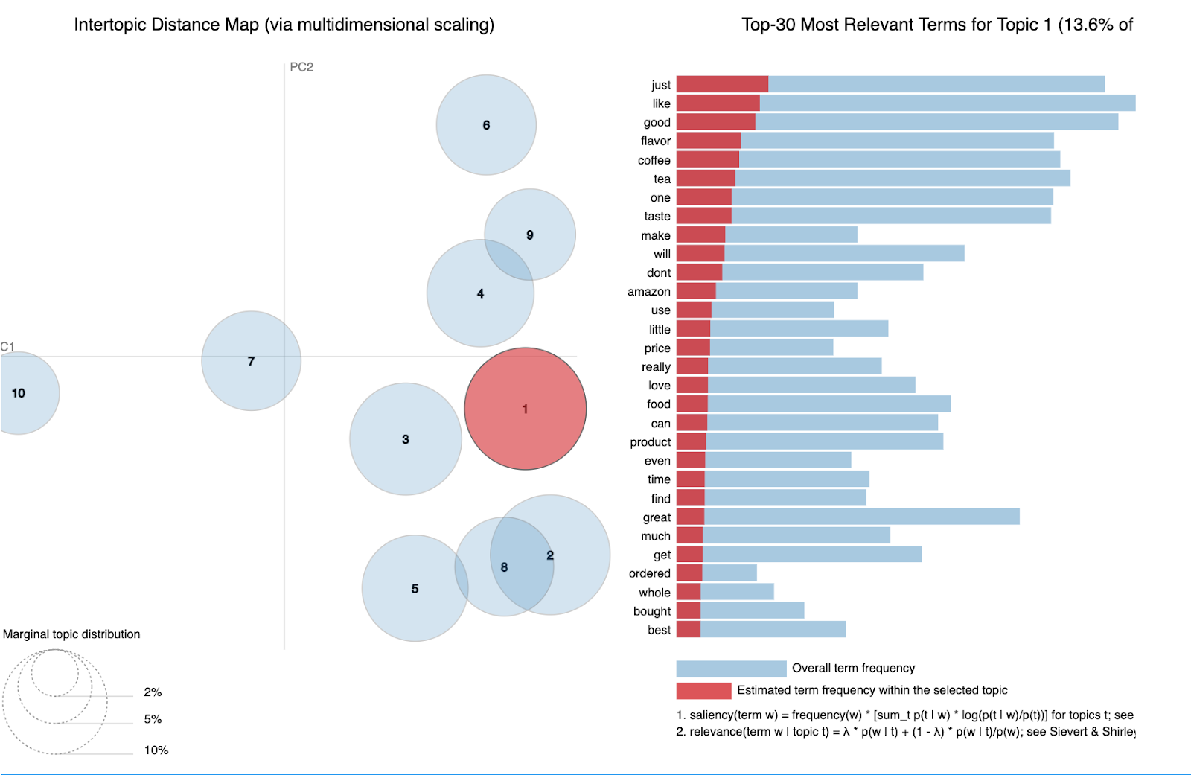

Slide 12
Non-Negative Matrix Factorization (NMF)
Alternate model to LDA
LDA: more probabilistic
Goal is to reduce dimensionality
Text corpus is converted into feature vectors
Feature vectors indicate how “important” each word is to the topic

Slide 13
NMF Data Preprocessing
Similar to preprocessing in LDA models
NLTK: for stopwords
Regex: used to take out punctuation, special characters
Gensim: used to create dictionary of unique word tokens
Scikit-learn TfidfVectorizer
Term frequency-inverse document frequency (TF-IDF) feature vectors
Calculates importance value of each word per review text
LDA uses CountVectorizer to obtain raw term count (probabilistic)

Slide 14
NMF Model Creation
Initialization:
n_components: set to 9 to extract number of topics
init=”nnsvd”: non-negative double singular value decomposition
Helps to handle sparse matrices from TF-IDF feature vectors
Features per topic:
TfidfVectorizer.get_feature_names()
Plot function:
plot_words(): generates plots of the topics and the words within each topic

Slide 15
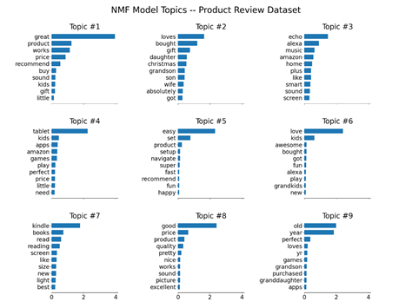
NMF Results -- Product Reviews
Notable topics
Topic #3: technology
Topic #7: reading products
Topic #9: grandparents, grandchildren

Slide 16
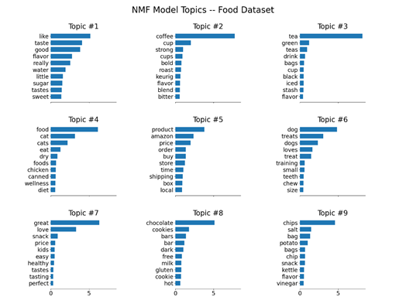
NMF Results -- Food Reviews
Notable topics
Topic #1: flavor and taste
Topic #2: coffee
Topic #3: tea
Topic #4: cat food
Topic #6: dog food

Slide 17
Conclusion
LDA and NMF models both useful for extracting topics from a text dataset
We can observe similar topics between both models
Extracted topics are distinct, and their top words provide insight to the various topics within the dataset
Output affected by preprocessing techniques
There are many parameters to adjust when initializing LDA and NMF models, need to experiment with each to observe differences in performance and output

